Slide 1

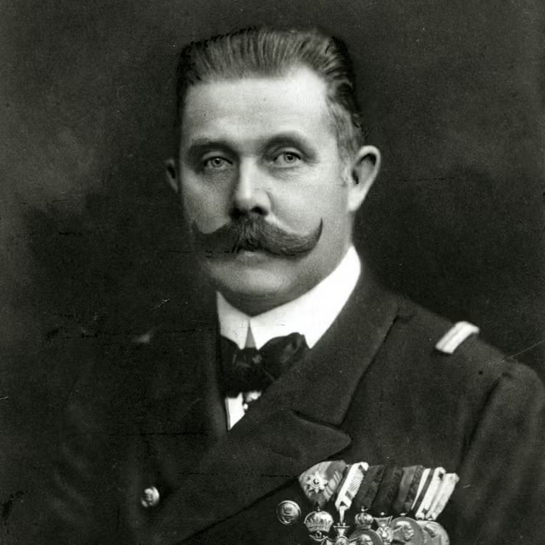
Title: How Did the Assassination of Franz Ferdinand Lead to the First World War?
LO: How did the assassination increase tensions and trigger a wider European conflict?
Title: The Assassination of Archduke Franz Ferdinand
Key Enquiry Question: What were the causes of WW1, and how did different factors contribute to the outbreak of the conflict?
Last Lesson: What was the ‘Arms Race’ and how did it show competition instead of peace?
Two Lessons Ago: Which countries joined the ‘Triple Alliance’ and the ‘Triple Entente’ and what does this tell us about loyalty between nations?
Three Lessons Ago: What is the difference between an ‘Empire’ and a ‘Colony’ and how does this link to fairness and power?

Slide 2
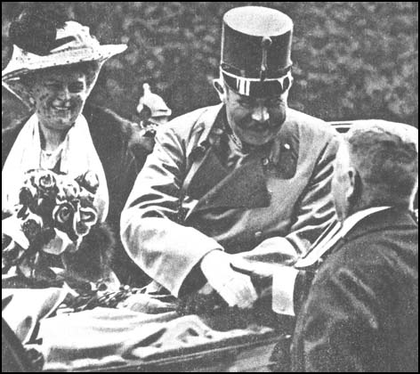
Title: How Did the Assassination of Franz Ferdinand Lead to the First World War?
LO: How did the assassination increase tensions and trigger a wider European conflict?
Key Enquiry Question: What were the causes of WW1, and how did different factors contribute to the outbreak of the conflict?
Success Criteria:
🧭 Meeting:
Can identify key events and individuals involved in the assassination of Franz Ferdinand.
🔎 Exceeding:
Can explain how the assassination increased tensions between Austria-Hungary and Serbia.
🧠 Mastering:
Can analyse how the assassination and the reactions of European powers contributed to the outbreak of the First World War.

Slide 3
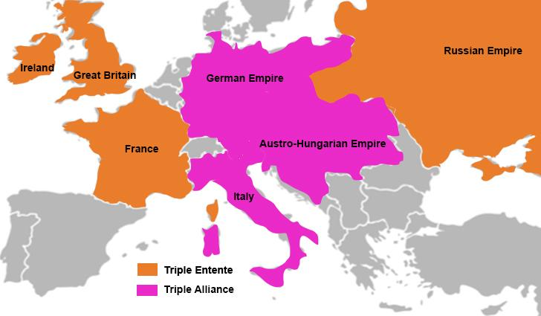
Title: How Did the Assassination of Franz Ferdinand Lead to the First World War?
LO: How did the assassination increase tensions and trigger a wider European conflict?
What were the main causes of WW1?
Key Enquiry Question: What were the causes of WW1, and how did different factors contribute to the outbreak of the conflict?
Remember the acronym MAINS:
M is for Militarism
A is for the Alliance System
I is for Imperialism
N is for Nationalism
S is for Significant Individuals

Slide 4



Title: How Did the Assassination of Franz Ferdinand Lead to the First World War?
LO: How did the assassination increase tensions and trigger a wider European conflict?
Keywords:
Assassination 暗杀 암살 |  | The planned killing 计划杀戮 of an important person, usually for political reasons 政治原因.
The Black Hand 黑手党 블랙 핸드 |  | A secret Serbian nationalist group that supported uniting Serbian people and used violence to pursue its aims.
Nationalism 民族主义 민족주의 |  | The idea that people who share the same culture, language, or history should have their own country.

Slide 5
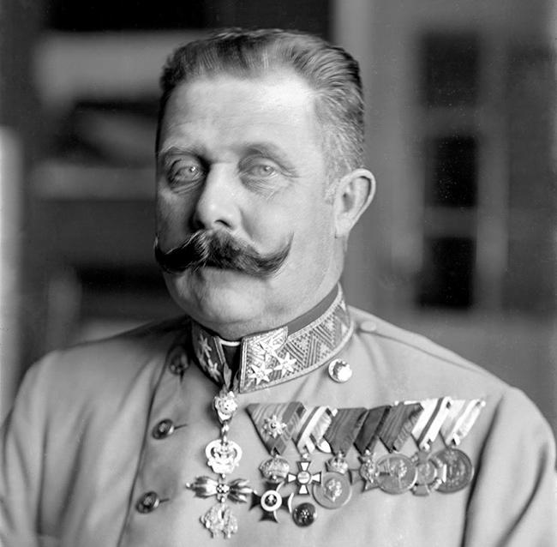
Who was Franz Ferdinand?
He was next to become emperor / king of Austria – Hungary.
He became heir to the throne after the emperor's son, Crown Prince Rudolf, died in 1889. His father, Karl Ludwig, later gave up his claim to the throne.
Why did he matter?
As heir to the throne, Franz Ferdinand was an important figure in Austria-Hungary. His assassination would create a major political crisis.

Slide 6
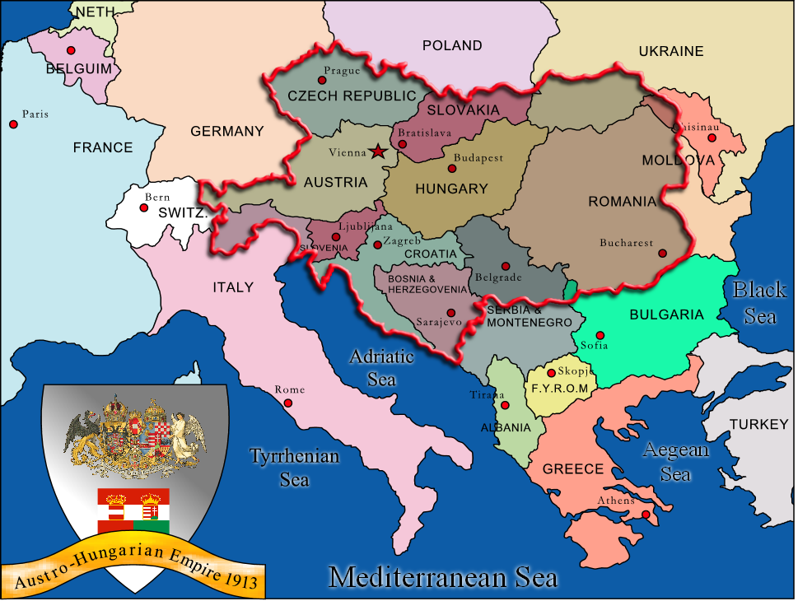
Title: How Did the Assassination of Franz Ferdinand Lead to the First World War?
LO: How did the assassination increase tensions and trigger a wider European conflict?
A Shot that Changed the World!
On 28 June 1914, Franz Ferdinand and his wife Sophie visited Sarajevo in Bosnia.
Many Serbian nationalists opposed Austro-Hungarian control of Serbia. They wanted Serbian people living there to be united with Serbia.
The visit took place on Vidovdan, an important date in Serbian history and national identity. It was a time for Serbs to remember their history and celebrate pride in their nation (nationalism). This added significance to the visit in an already tense region.
Tensions between Austro-Hungarian authorities and Serbian nationalists formed the background to the assassination in Sarajevo.

Slide 7
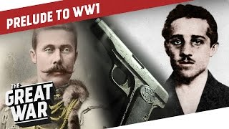
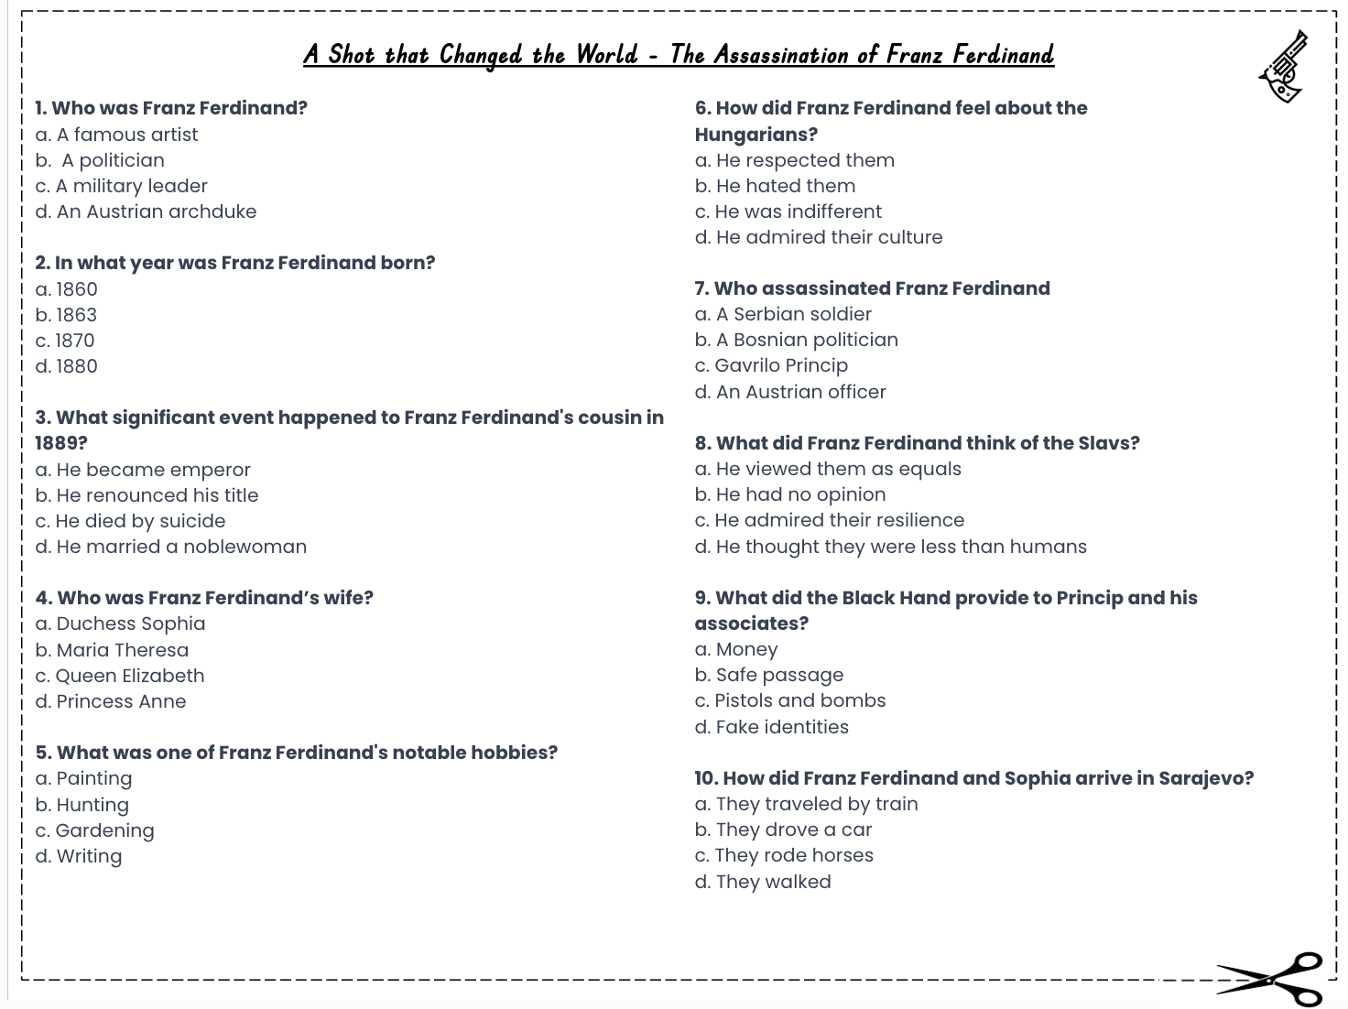
Title: How Did the Assassination of Franz Ferdinand Lead to the First World War?
LO: How did the assassination increase tensions and trigger a wider European conflict?
A Shot that Changed the World!
Activity: Complete the multiple choice questions whilst watching the video:
A Shot that Changed the World
Notes:
https://www.youtube.com/watch?v=ZmHxq28440c

Slide 8

Title: How Did the Assassination of Franz Ferdinand Lead to the First World War?
LO: How did the assassination increase tensions and trigger a wider European conflict?
A Shot that Changed the World!
d. An Austrian archduke
b. 1863
c. He died by suicide
a. Duchess Sophia (Sophie Chotek)
b. Hunting
b. He hated them
c. Gavrilo Princip
d. He thought they were less than humans
c. Pistols and bombs
b. They drove a car
GREEN PEN YOUR ANSWERS

Slide 9
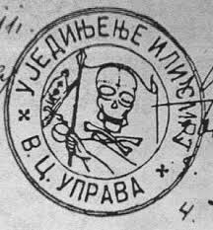

Title: How Did the Assassination of Franz Ferdinand Lead to the First World War?
LO: How did the assassination increase tensions and trigger a wider European conflict?
The Black Hand Gang
The Black Hand, also called Unification or Death, was a secret Serbian nationalist group formed in 1911.
They wanted all Serbian people to be united in one country and were willing to use violence to achieve it.
Serbia had gained independence from the Ottoman Empire in the nineteenth century (1800’s), but many Serbs still lived under Austro-Hungarian rule.
When Austria-Hungary took control of Bosnia in 1908, Serbian nationalists were angry because it blocked their dream of a united Serbia.
The Black Hand trained young people in weapons and bomb-making and had some support from Serbian military leaders.

Slide 10






Title: How Did the Assassination of Franz Ferdinand Lead to the First World War?
LO: How did the assassination increase tensions and trigger a wider European conflict?
From Assassination to World War!
Activities:
Part A — Sequence the Events
In pairs number the six events in the correct chronological order.
Use the historical reference sheet to help you.
How did the decisions made by Germany, Austria-Hungary and Russia help turn the assassination into a wider conflict? Explain your answer using historical evidence.
Which was more important in causing the First World War: the assassination itself or the decisions made by European leaders? Justify your judgement using historical evidence.
Notes:
https://www.youtube.com/watch?v=f4q7BqKw50c

Slide 11
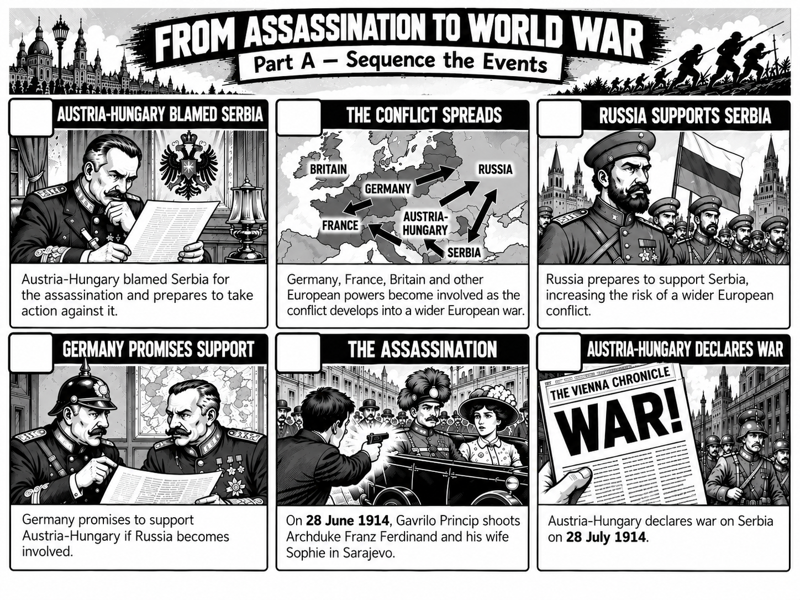


Slide 12

Title: How Did the Assassination of Franz Ferdinand Lead to the First World War?
LO: How did the assassination increase tensions and trigger a wider European conflict?
From Assassination to World War!
Part A — Sequence the Events
The correct chronological order is:
The Assassination — On 28 June 1914, Gavrilo Princip shoots Archduke Franz Ferdinand and his wife Sophie in Sarajevo.
Austria-Hungary Blamed Serbia — Austria-Hungary blamed Serbia for the assassination.
Germany Promises Support — Germany promises to support Austria-Hungary if Russia becomes involved.
Austria-Hungary Declares War - Austria-Hungary declares war on Serbia on 28 July 1914.
Russia Supports Serbia — Russia prepares to support Serbia against Austria-Hungary.
The Conflict Spreads — Germany, France and Britain become involved as the crisis develops into a wider European war.

Slide 13
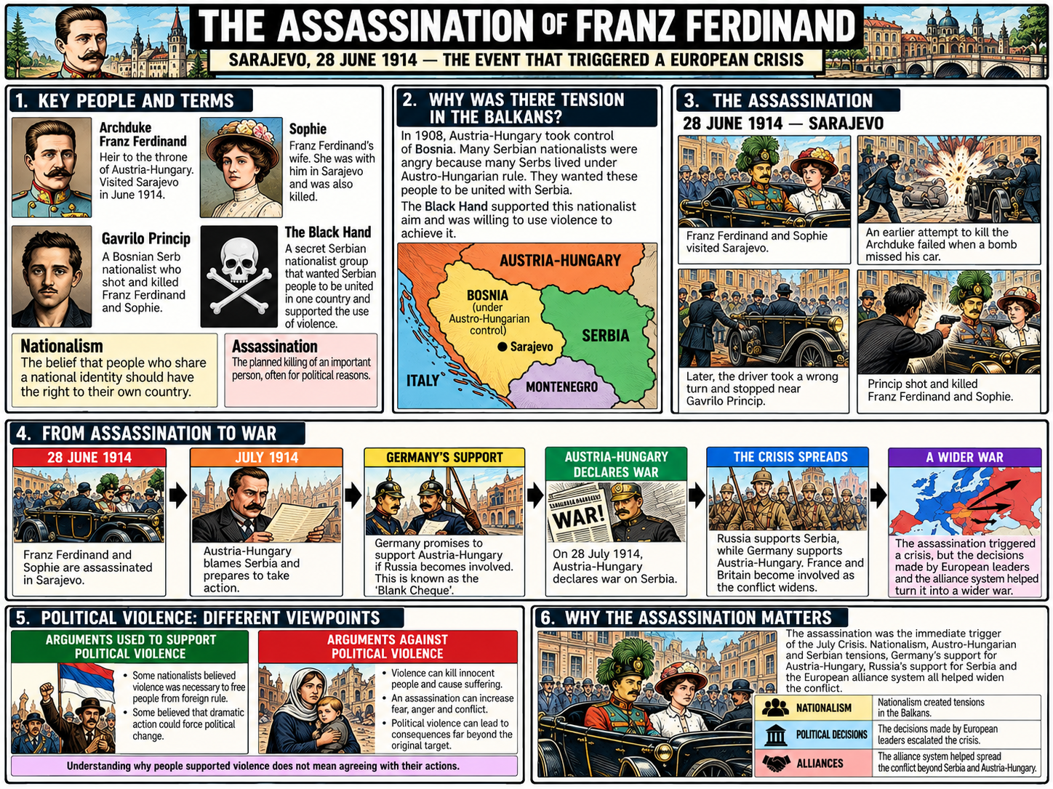

Slide 14
Title: How Did the Assassination of Franz Ferdinand Lead to the First World War?
LO: How did the assassination increase tensions and trigger a wider European conflict?
From Assassination to World War!
Part B — Explain the Events
Answer the questions in full sentences individually in your book.
Why did Austria-Hungary blame Serbia for the assassination? 奥匈帝国为什么指责塞尔维亚是暗杀的凶手？
How did Germany’s support make the crisis more dangerous? 德国的支持如何使危机更加危险？
How did the conflict spread across Europe? 这场冲突是如何蔓延到整个欧洲的？
How did the decisions made by Germany, Austria-Hungary and Russia help turn the assassination into a wider conflict? Explain your answer using historical evidence.
Which was more important in causing the First World War: the assassination itself or the decisions made by European leaders? Justify your judgement using historical evidence.
Notes:
https://www.youtube.com/watch?v=f4q7BqKw50c

Slide 15
1. Why did Austria-Hungary blame Serbia for the assassination?
Austria-Hungary blamed Serbia because Gavrilo Princip was a Bosnian Serb nationalist who wanted Serbian people to be united in one country. Austria-Hungary suspected that Serbian nationalism threatened its control of Bosnia.
2. How did Germany’s support make the crisis more dangerous?
Germany promised to support Austria-Hungary if Russia became involved. This gave Austria-Hungary confidence to take stronger action against Serbia and increased the risk that other European powers would become involved.
3. How did the conflict spread across Europe?
Austria-Hungary declared war on Serbia, while Russia prepared to support Serbia. Germany supported Austria-Hungary, and France and Britain became involved as the crisis widened. The alliances and decisions of European leaders helped turn a conflict between two countries into a wider war.

Slide 16





Title: How Did the Assassination of Franz Ferdinand Lead to the First World War?
LO: How did the assassination increase tensions and trigger a wider European conflict?
True Or False
1. Franz Ferdinand was assassinated in Sarajevo because he was already the ruler of Austria-Hungary.
2. Serbian nationalists opposed Austro-Hungarian rule in Bosnia because they wanted unity.
3. The Black Hand supported the use of violence to achieve Serbian nationalist aims.
4. Austria-Hungary declared war on Serbia before Germany promised to support it.
5. Germany’s promise to support Austria-Hungary increased the risk of other European powers becoming involved.
6. The assassination made a wider European war inevitable, regardless of the decisions made by political leaders.
Notes:
https://dashboard.blooket.com/set/68cf81fc86e27c0a383a6956

